Slide 1

IOT BASED PROJECT HOME AUTOMATION
EMERTXE IOT INTERNSHIP
Submitted By:
SRI KRISHNA COLLEGE OF TECHNOLOGY
COIMBATORE
Submitted To:Jayalaxmi N.Dhayal
SNEHA LAKSHMI S

Slide 2

TABLE OF CONTENT
About the Internship
Topics learned in the internship
What is IOT ?
What is Embedded System ?
C/C++ (OOPS Concept)
About the Project
Implementation of the Project
Conclusion

Slide 3
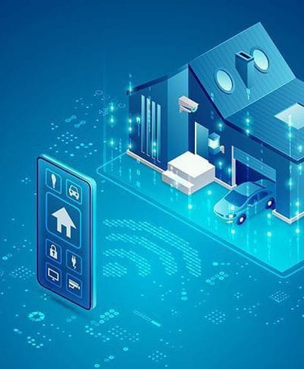
ABOUT THE INTERNSHIP
Emertxe Information Technology, Banglore
Duration 4 Weeks
Organized , Structured and Standard
Learning with Implementation
Student support (Moodle LMS)
Free Resources and Tools
Project Based Learning
Weekly Evaluation of Student

Slide 4
TOPICS TO LEARN
C/C++ PROGRAMMING
IOT Introduction
Workshop
OOPS Concept
Embedded System

Slide 5
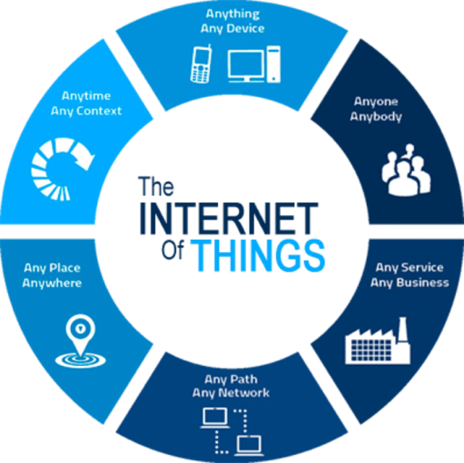
WHAT IS IOT ?
IoT — The Internet of Things
Internet : Network
Things : Objects
The Combination of objects with the help of network (Internet).
IoT is the network of physical objects
Collection of electronics, software, sensors, and network connectivity, which collect and exchange the data

Slide 6
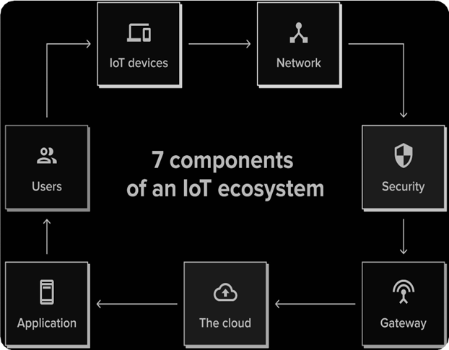
ECOSYSTEM OF IOT
IOT Devices
Network
Security
Gateway
The Cloud
Application
Users

Slide 7
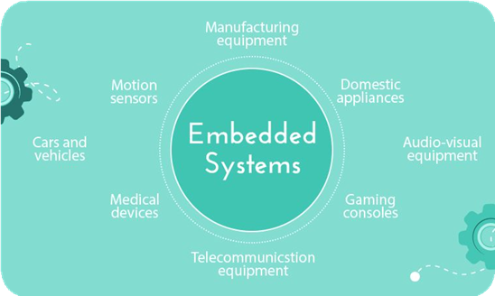
What is Embedded System ?
An embedded system is a combination of computer hardware and software designed for a specific function.
An Embedded system is a computer system which is the combination of the processor, memory, and input/output peripheral systems.

Slide 8

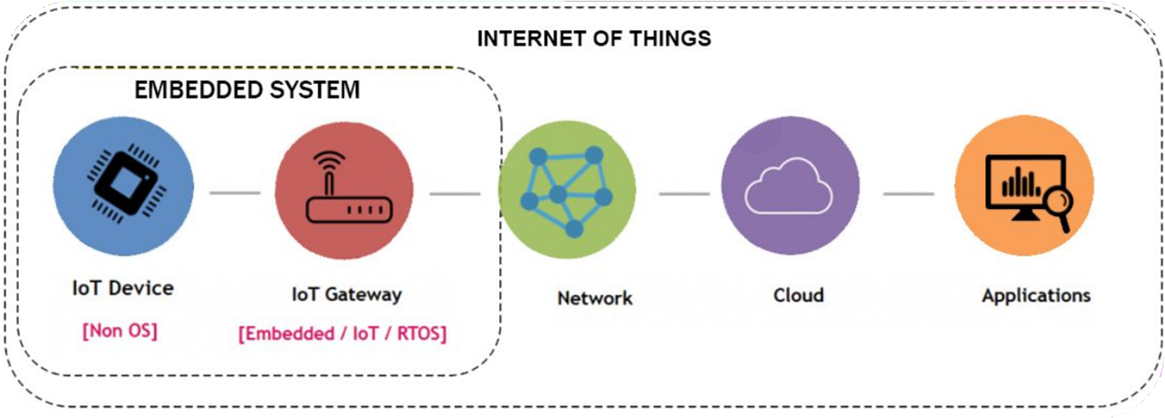
An Embedded System and IOT
The Difference between an embedded system and IOT is an embedded system is a subset of the IOT

Slide 9
TYPES OF EMBEDDED SYSTEM
Cellphones
Laptops
Smartwatches
Real Time Embedded Systems
Stand Alone Embedded System
Networked Embedded systems
Mobile Embedded Systems
Digital Cameras
Music Players
Washing Machines
Self-Driving Vehicle Controls
Aircraft Controls System
Home security systems
ATMs(Automated Teller Machines)
Point of sale Systems

Slide 10
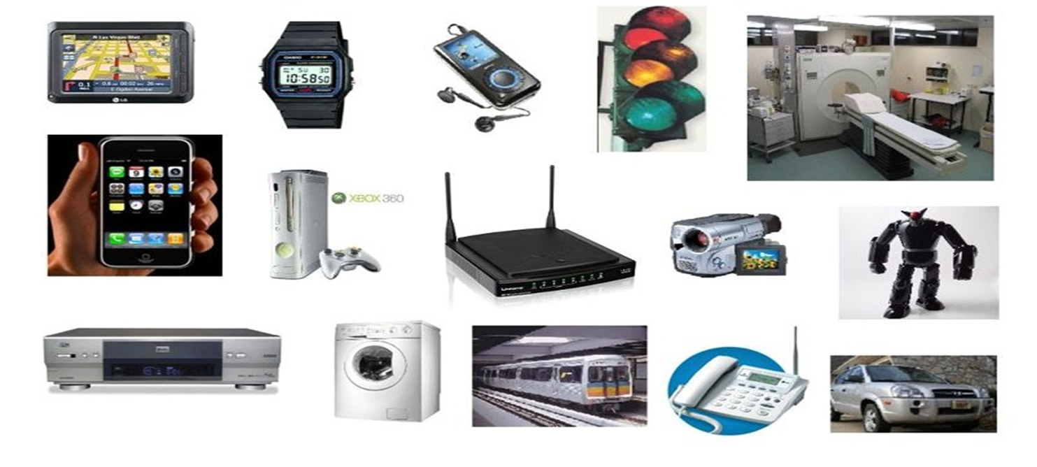
EXAMPLES OF EMBEDDED SYSTEMS

Slide 11

Areas of focus
C/C++ PROGRAMMING
INTERMEDIATE
BASICS
Variables
Keywords
Datatypes
Operators
Conditionals
Loops
ADVANCED
Arrays
Pointers
Functions
Storage Classes
Files
Preprocessor
C++ overview
Class and Objects
Abstraction
Inheritance
Encapsulation
Polymorphism

Slide 12
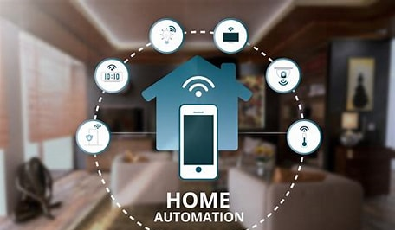
ABOUT THE PROJECT HOME AUTOMATION Requirements :
Garden Lights Control
Temperature Control
Heater Control
Threshold Temp. Control
Water Tank Control
Inlet and Outlet Valves Control
Display Water Volume
Displaying the progress and notified on the mobile (Blynk) app and CLCD with automatic actions

Slide 13
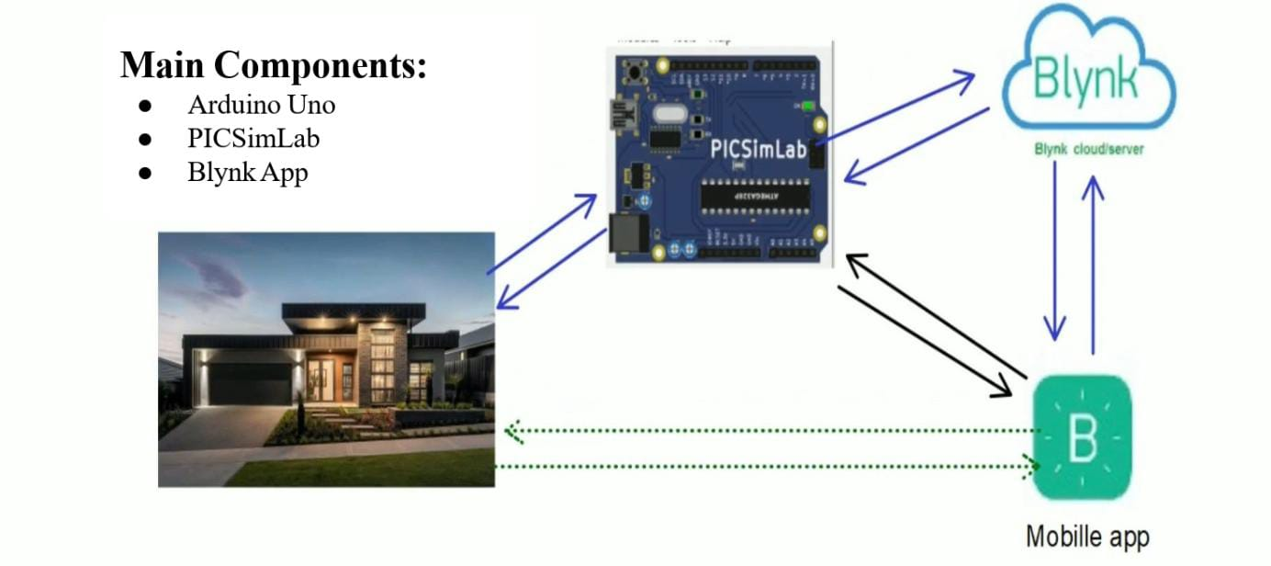
ABOUT THE PROJECT

Slide 14
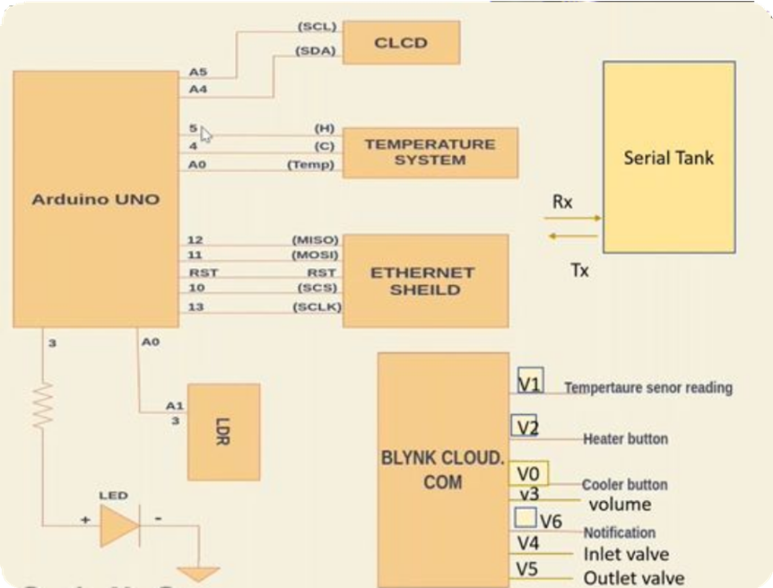
Peripherals
LEDs
Temperature System
CLCD
LDR
Serial Tank(Serial Communication)
Ethernet Shield

Slide 15
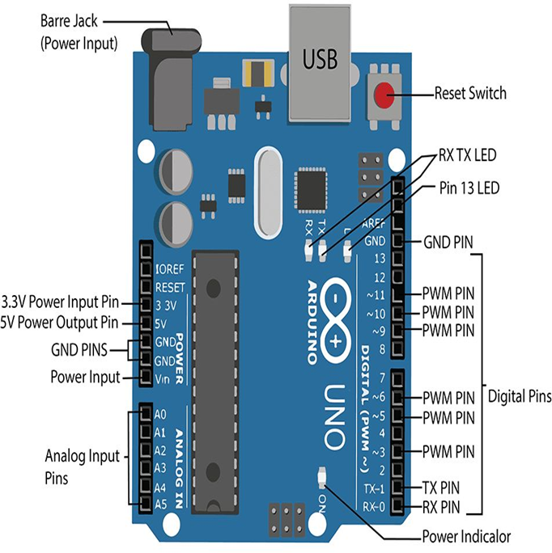
About the Project
●Arduino UNO is based on an ATmega328P microcontroller.
●It is easy to use compared to other boards, such as the Arduino Mega board, etc. The board consists of digital and analog Input / Output pins (I/O), shields, and other circuits.
●The Arduino UNO includes 6 analog pin inputs, 14 digital pins, a USB connector, a power jack, and an ICSP (In-Circuit Serial Programming) header.

Slide 16
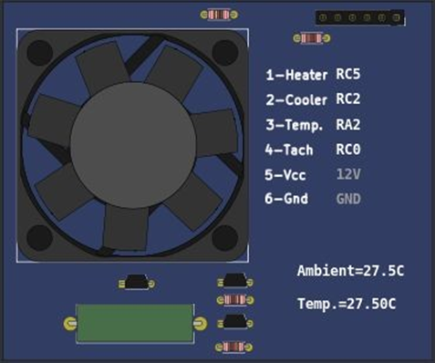
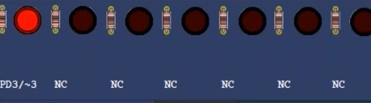
ABOUT THE PROJECT
LEDs (Light Emitting Diode)
TEMPERATURE SYSTEM

Slide 17
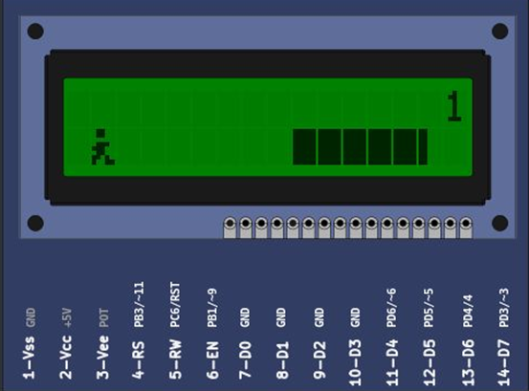
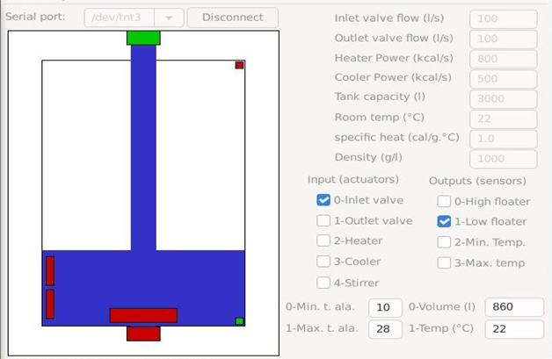
ABOUT THE PROJECT
CLCD (16 X 2) Liquid Crystal Display Remote Serial Tank

Slide 18
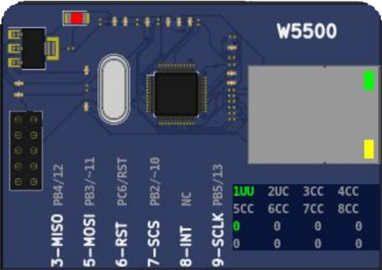
ABOUT THE PROJECT
ETH W5500
● The W5500 chip is a Hardwired TCP/IP embedded Ethernet controller that provides easier Internet connection to the embedded system.
●W5500 enables users to have the Internet connectivity in their applications just by using the single chip in which TCP/IP stack, 10/100 Ethernet MAC and PHY embedded.
●Supports Wake on LAN over UDP. Supports High Speed Serial Peripheral Interface(SPI MODE 0,3).

Slide 19
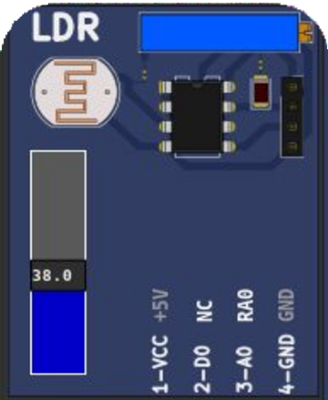
ABOUT THE PROJECT
LDR (Light dependent resistor) SENSOR
●An LDR is a component that has a (variable) resistance that changes with the light intensity that falls upon it. This allows them to be used in light sensing circuits.
The resistance of a Photo resistor decreases with increasing incident light intensity. In other words, it
Exhibits photoconductivity.

Slide 20
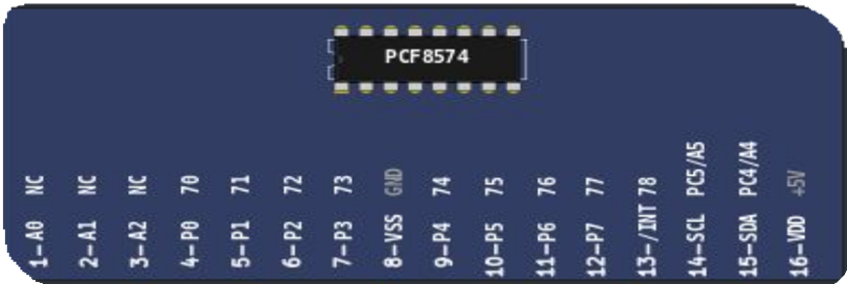
PCF 8574
●The PCF8574 is a silicon CMOS circuit
●It provides general purpose remote I/O expansion for most microcontroller families via the two-line bidirectional bus (12C inter-IC).
●The device consists of an 8-bit quasi-bidirectional port and an I2C-bus interface.

Slide 21
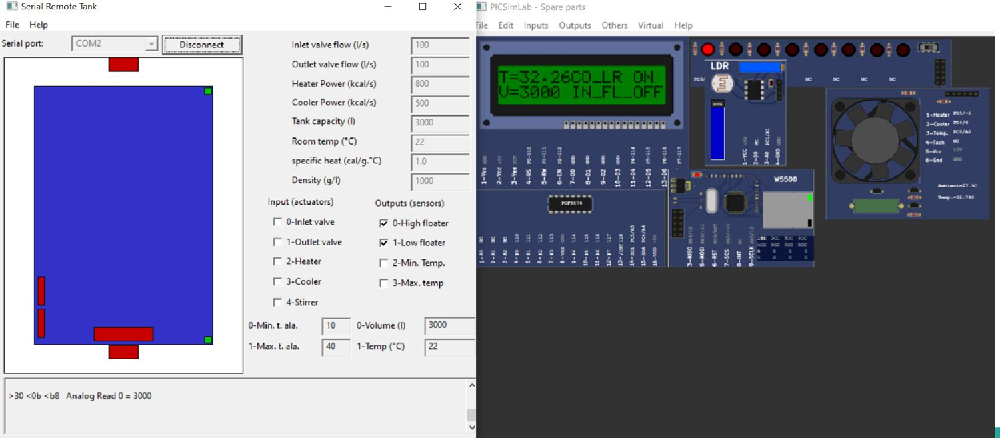
PROJECT IMPLEMENTATION

Slide 22
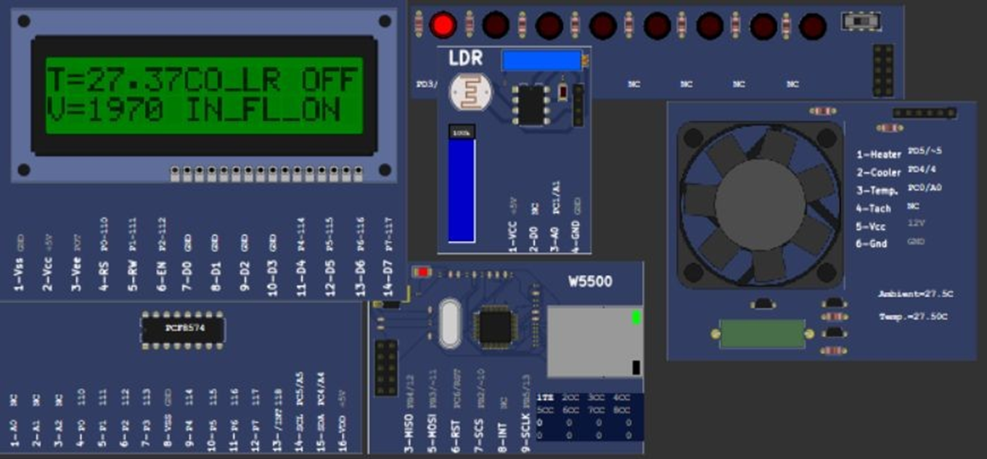
PROJECT IMPLEMENTATION

Slide 23
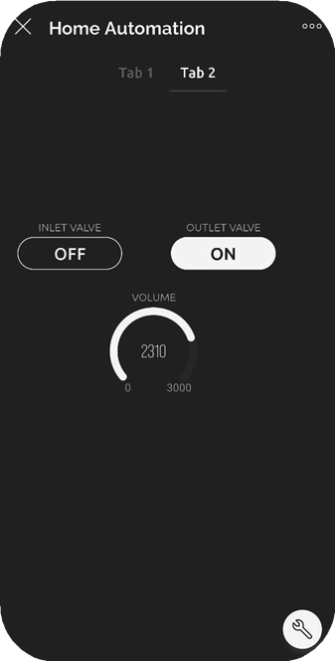
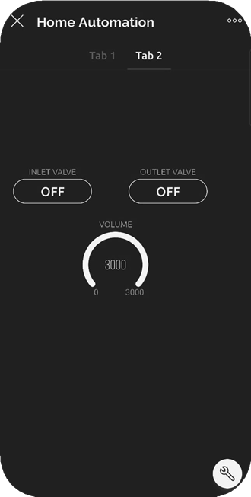
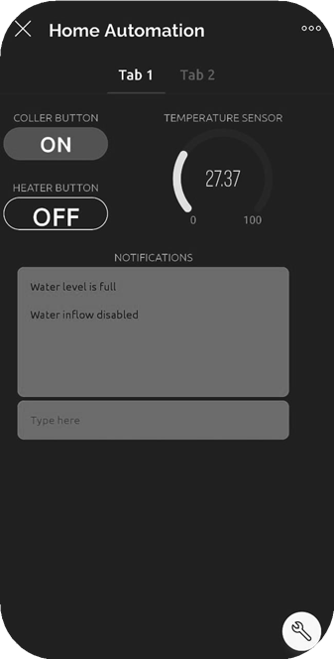
PROJECT IMPLEMENTATION

Slide 24
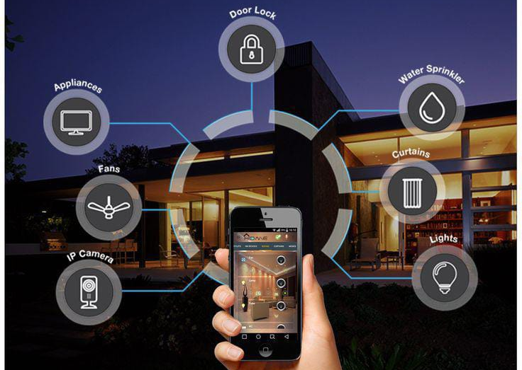
CONCLUSION
Using blynk IoT application and Picsimlab simulator, simulated home automation, where LED, temperature system, Serial tank resembles Light, Heater, Cooler and Water tank in real time.
CLCD acts like a dashboard used for displaying the events, Widgets from Blynk IoT app like button widgets are used to control heater, cooler and inlet valve, outlet valve.
Gauge widgets to display the temperature and volume of the water.

Slide 25
THANK YOU
If you think that the Internet has changed your life, think again. The Internet of Things is about to change it all over again !
~ Brendan O'Brien

